Slide 1
We Shall Overcome Song
Author
Institutional Affiliation
Instructor
Course code
Date of submission

Slide 2
We shall overcome song
This was basically a gospel song which later was transformed to be a protest song.
It also became the anthem for the civil movement unions.
The song is attributed to be a lyrically descended from “ I’ii Overcome Some Day” this was a hymn authored by Charles Albert Tindley first being published in 1901.
Later the first song was being heard at the tobacco workers being led by Lucille Simmons in the year of 1945 following the striking of cigar workers in south Carolina- Charleston.
In 1947 it was published by the tittle “We Will Overcome”

Slide 3
Theme: Civil Rights
Civil rights theme was an anthem in the song “We shall overcome”.
This was a quote that was quoted by Rev. Marthin Luther King junior.
Later this quote was made popular by the folk singer by the name Pete Seenger.
It was from the popularity of the quote from the singer that the quote “We shall overcome” was made or declared part of the public domain.

Slide 4
Social Origin
Its origin can be traced from the lawsuit prosecutors who included African-American spirituals.
In the year 1940s a song by the name “ We will Overcome” emerged. The song was aimed in striking tobacco workers in South Carolina.
The African-American women strikers were seeking for pay in crease up to 30 cents per an hour.
They all sang the song as they were picking Tobacco. Later it was the favorite song for Lucille Simons who was one of the stikers, “I Will Overcome”.
Later the song become the teaching subject in Highlander Folk School in Tennessee.
This was an educational center which was used to train labor organizers and civil-rights leaders for example John Lewis, King, Parks and Rosa.

Slide 5
Historical origin of the theme
Historically the theme emerged based on the famous hymn “If My Jesus Will”.
It is from here the folk singer Pete Seeger derived the anthem for civil rights “We Shall Overcome”.
He did so after he heard it being sung by striking African-American working in tobacco farms in the late 1940s.

Slide 6
Political origin of the theme
In march of 1965 black were Americans were not still able to vote.
Incase they came out to register they were being exposed to questions that they were not in a position to answer and much humiliation for example, “how many bubbles in a bar of soap?”
For instance the ones who managed to register, during the voting period they were being beaten if they appeared at the polling station.
As time went by civil rights leaders noticed that Johnson provided no help for their recovery of civil rights since he had voted in 1964 the voting bill but it had not been gazzeted as a voting rights bill.

Slide 7
Some civil rights leaders initiated a talk with the Lyndon Johnson who was now the president. As they had hope in him as per his 1965 aspiring under good faith.
But later the mass movement of the protestors out the white house was still experienced as well as distrusting him.
Also the former students of president Johnson together with women and men at Georgetown also had more hope based on Jonson’s sincerity.
All of them believed truly Johnson was to help the poor especially people of color as he was held back his ambition

Slide 8
In 1957 Johnson realized that he might not be the president unless by the removal of the “magnolia scent” from the south as he set out to pass the civil rights bill.
Later his received bill was the weak one as the civil rights leaders blamed him due to it since it made meager advances.
As per this the protests went one as they had no faith with president Johnson again.
He later said that it was to take 135 years before even for blacks to be half way registered in Mississippi.
The limousines was still pulling the gate in that night as the protestors were singing “We Shall Overcome” this was simply telling Johnson that they will still do it without him.

Slide 9
Poets of civil rights
Audre Lorde 1934-1992
W.E.B Du Bois 1868-1963
Michael S. Harper 1938-2016
Pauli Murray 1910- 1985

Slide 10
Painters of civil rights
Barkley L. Hendricks 1945-2017
Jack Whitten 1939-1018
David Hammons
Frank Cieciorka 1939-2008

Slide 11
Sculptors of civil rights
Benny Andrews (America, 1930-2006)
Jacob lawrence ( American, 1917-2000)
Philip Guston ( American born Canada, 1913-1980)
Emma Amos ( American, Born 1938)
Moneta Sleet Jr.
Robert Indiana ( America, Born 1928)

Slide 12
WRITERS OF CIVIL WAR
The poets
The novelists
The scholars
The playwrights

Slide 13
MUCICIANS OF CIVIL RIGHTS
Pete Seeger who performed several concerts to raise capital for civil rights organizations
Jamila Jones. She was a gospel singer, in 1998 she came to the Highlinder Folk School for nonviolent activist training.
Guy and Candie Carawan who produced jubilant songs in significant of moods.

Slide 14
PHOTOGRAPHERS
Bob Fitch
Benedict J. Fernandez
Bruce Davidson
Bob Adelman
Dan Budnik

Slide 15
ARCHTECTS OF CIVIL RIGHTS
Rosa parks .
Malcolm X.
Martin Luther King Jr.
Charles Sumner

Slide 16
CHOREOGRAPHERS OF CIVIL WAR
Willie Hinton.
L.D. Burris.
Tara Z. Mullins

Slide 17
DANCERS OF CIVIL RIGHTS
Dance Research Journal which promotes interdesciplinary tactics to dance and welcome scholars in dance education and relevant fields.
The Congress on Research in Dance (CORD). It encourages research in all aspects of dance and enhance exchange of ideas. It also promote the accessibility of research materials.

Slide 18
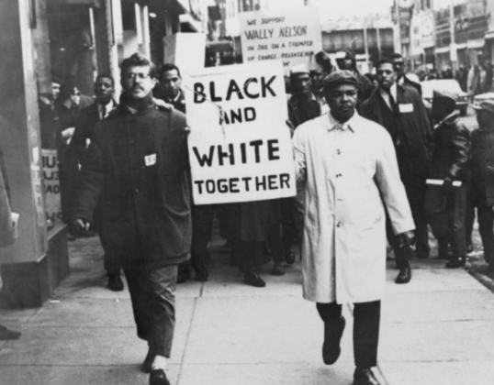
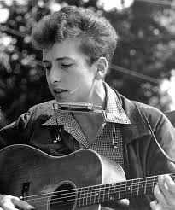
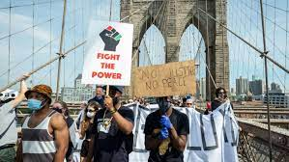
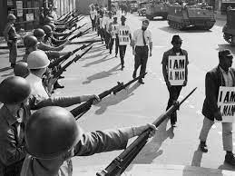
Visual representation of civil war

Slide 19
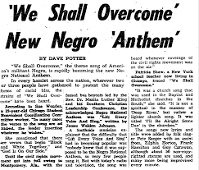
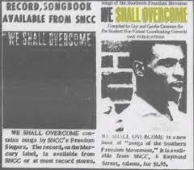
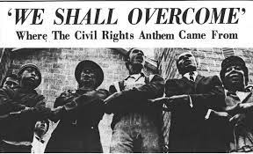

Slide 20
References
Finlayson, R. (2003). We Shall Overcome: The History of the American Civil Rights Movement. Twenty-First Century Books.
Stacks, S. (2016). We Shall Overcome: Essays on a Great American Song.

